Slide 1
CAPSTONE PROJECT - 1
EDA On Airbnb Booking Analysis
BY
Ankur Nain

Slide 2
Airbnb Bussiness
Airbnb (ABNB) is an online marketplace that connects people who want to rent out their homes with people who are looking for accommodations in specific locales.
The company has come a long way since 2007, when its co-founders first came up with the idea to invite paying guests to sleep on an air mattress in their living room. According to Airbnb's latest data, it has in excess of six million listings, covering more than 100,000 cities and towns and 220-plus countries worldwide.
The idea behind Airbnb is simple: Find a way for local people to make some extra money renting out their spare home or room to people visiting the area. Hosts using this platform get to advertise their rentals to millions of people worldwide, with the reassurance that a big company will handle payments and offer support when needed. And for guests, Airbnb can offer a homey place to stay that has more character, perhaps even with a kitchen to avoid dining out, often at a lower price than what hotels charge.

Slide 3
For this we have analyze Airbnb ‘s New York City(NYC) data of 2019.NYC is not only the most famous
City in the world but also top global destination for visitors drawn to its museums,entertainment,restaurants and commerce.
Our main objective is to find out the key metrics that influence the listing of properties on the plateform.for this ,we will explore and visiualization the dataset from Airbnb in NYC using basic explorating data analysis(EDA)techniques.
Data analysis on thousands of listing provide through Airbnb is crucial factor for the company
We will be finding out the distribution of every Airbnb listing based on their location in NYC,including their price range ,room type ,listing and other related fators.

Slide 4
Understanding about given Data
Id – These gives us the listing id.
Name – Listing name.
Host_id/Name – host id/Name
Neighbourhood_group-NYC borough
Neighbourhood–NYC neighbourhood
Latitude- listing latitude
Longitude – listing longitude
Room_type-type of rooms (Entire home/apt,Private room ,shared room)
Price – listing price
Number_of_review & Last_review - Total number of reviews & Date of last review
Calculated_host_listing_count – total number of listing for this host
Availablity_365 – number of days listing is available
Number of data set were nearly 49000.

Slide 5
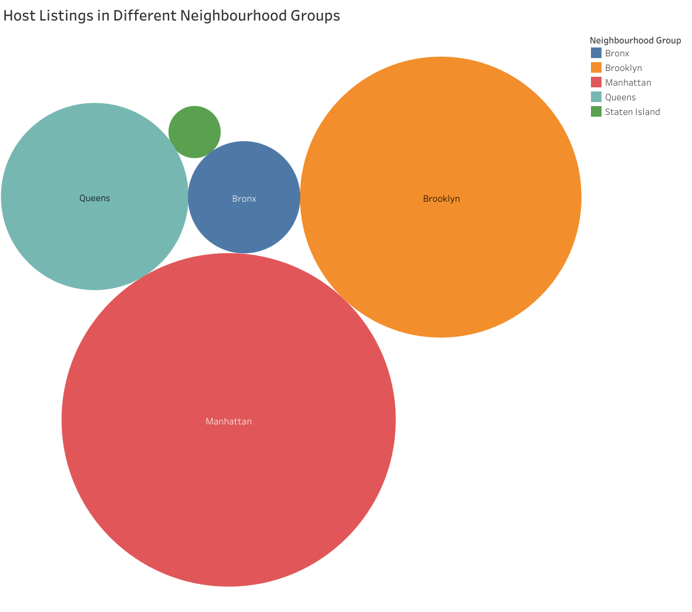

Slide 6
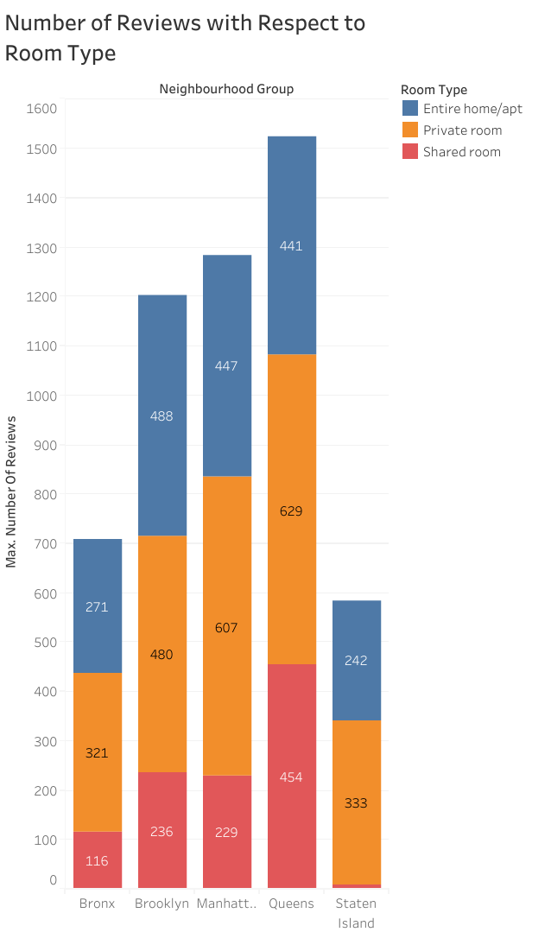

Slide 7
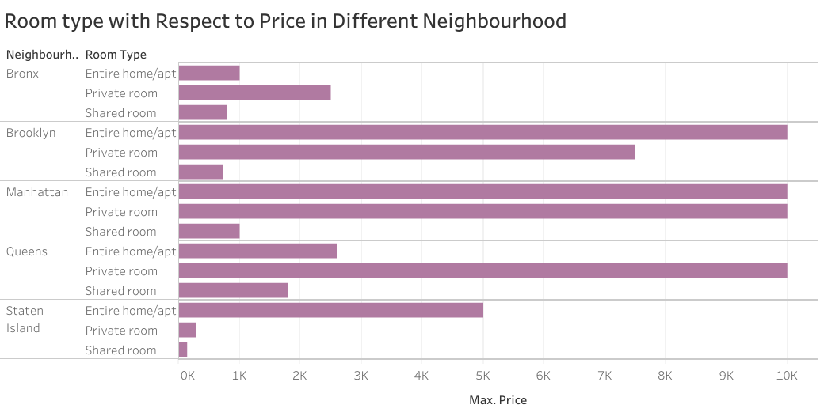

Slide 8
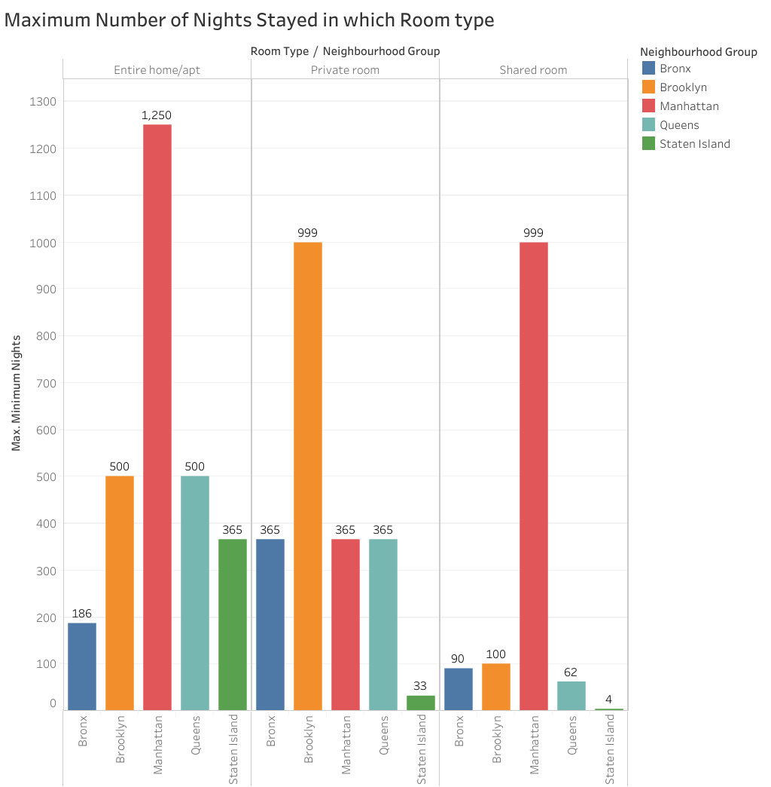

Slide 9

Challenge Faced
Reading the Dataset and understanding of columns.
For answering some of the question we had to understand the business model of Airbnb that how they work.
Handling NaN values ,null values and duplicates.
Designing multiple visualizations to summarize the information in the dataset and successfully cummunicate the results and trends to the reader .
Removing the outliers for some date set .finding and sorting few impossible dataset.

Slide 10

Analysis Summary
Manhattan is the most focused in New York for host to their business.
As people loved to stay when in need for maximum number of night in entire apartment and brooklyn stands second highest focused place by people .Also, as the average cost in Brookyl in 80 USD which is less then Manhattan Airbnb can increase number of entire apartment in Brooklyn .

Slide 11

FEW POINTS WHICH CAN HELP AIRBNB BUSINESS:
Top rated host as per number of review are Dona and jj.
Top most placed in nighbourhood is Williamsburg.
The availability of rooms in year is highest in Queens island and lowest in Brookyln.
So it is a greatest opportunity to increase some entire apartment in Brookyln.

Slide 12

Conclusion:
The people who prefer to stay in Entire home or Apartment they are going to stay bit longer in that particular Neighbourhood only .
The people who prefer to stay in private room they wont stay longer as compared to home or apartment .
Most people prefer to pay less price.
If there are more number of review for particular Neighbourhood group that means that place is a tourist place .
If people are not staying more than one night means they are travellers.

